Slide 1


Slide 2


Slide 3
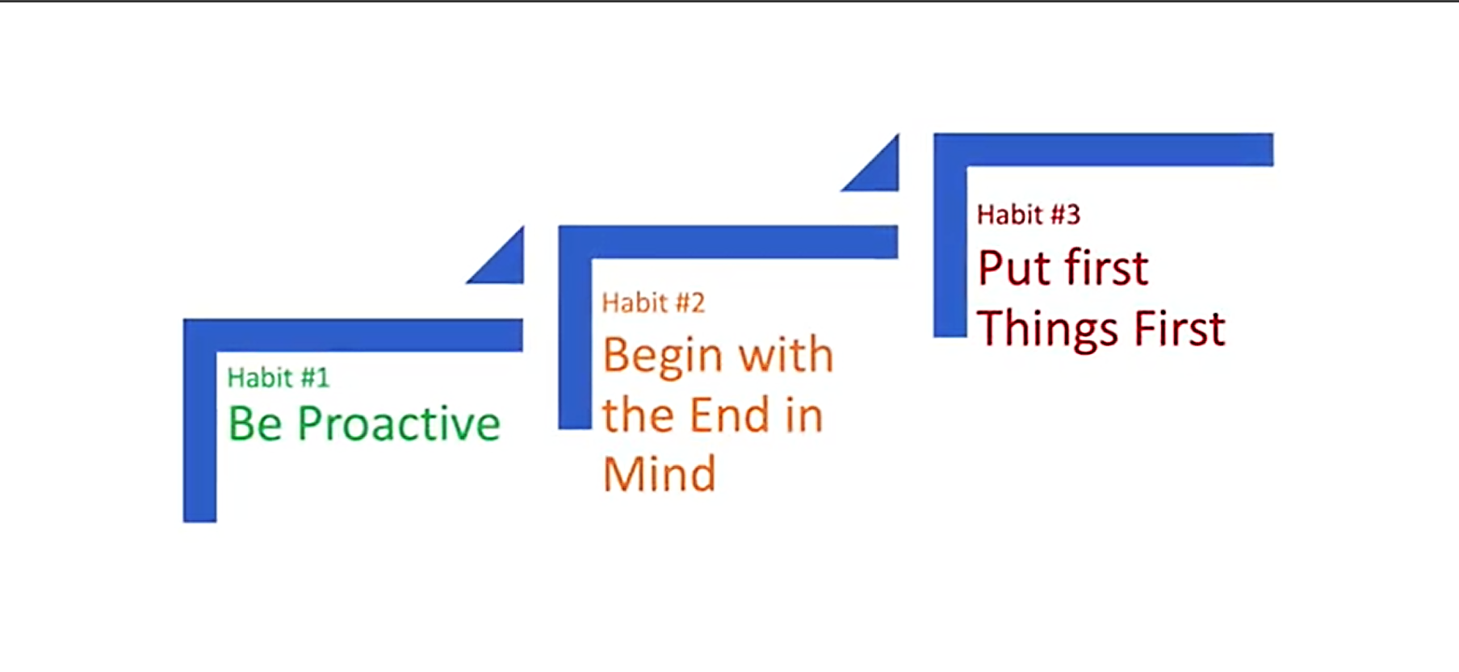
HABIT 3 is the
SECOND CREATION,
the Physical Creation
HABIT 2 is the FIRST or mental creation,
based on imagination & conscience
HABIT 1 says
“You’re the Creator.
You are in charge.”
Habits 1 & 2 are absolutely essential and pre-requisite to Habit 3.

Slide 4

HABIT 2 is LEADERSHIP while HABIT 3 is MANAGEMENT
LEADERSHIP vs. MANAGEMENT
Management is the breaking down, the analysis, the sequencing,
the specific application.

Slide 5

Effective Management is
PUTTING FIRST THINGS FIRST.
While leadership decides what “first things first” are,
it is management that puts them first day-by-day, moment-by-moment.
MANAGEMENT IS DISCIPLINE, carrying it out.
“Manage from left, lead from the right.”
Things which matter most must never be at the mercy of things which matter least. ~Goethe

Slide 6

The two factors that define an activity are urgent and important.
URGENT matters are usually visible. They press on us; they insist on action. They’re usually right in front of us. And often they are pleasant, easy, fun to do. But so often they are unimportant!
IMPORTANT matters has to do with results. It contributes to your mission, your values, your high priority goals.

Slide 7
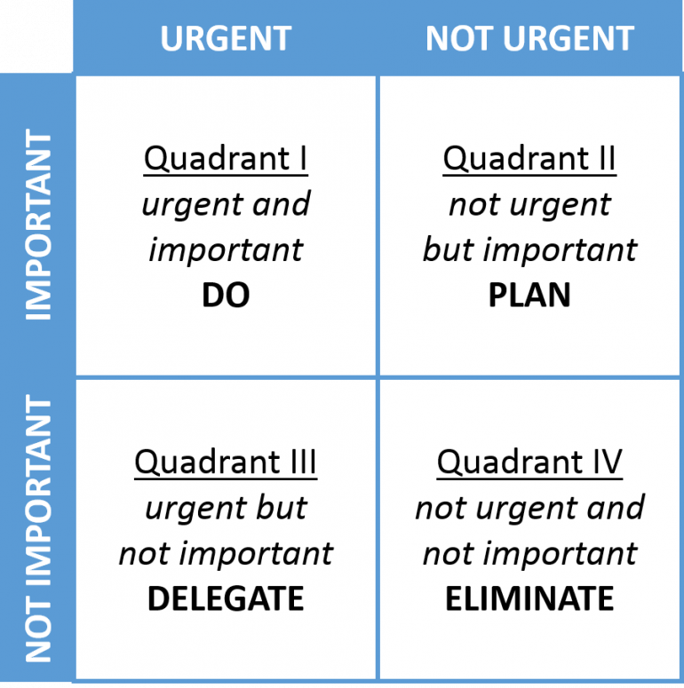
TIME MANAGEMENT MATRIX (4 Quadrants)
TO BE PRODUCTIVE & EFFECTIVE, you need to manage your time well.
The first step to
good time management
is to classify your
daily activities into
4 quadrants.

Slide 8
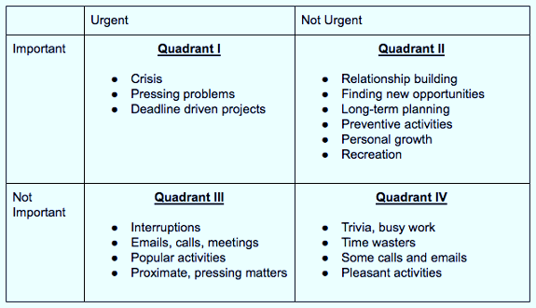
Quadrant I (Q1) is both urgent and important. It deals with significant results that require immediate attention. QI activities are usually called “crises” or “problems.”
Quadrant III (Q3)
Some people spend so much time in“urgent, but not important” activities.
They react to things that are urgent, assuming they are also important. But the reality is that the urgency of these matters is often based on the priorities and expectations of others.
People who spend time almost exclusively in Q3 and Q4 basically lead irresponsible lives.

Slide 9
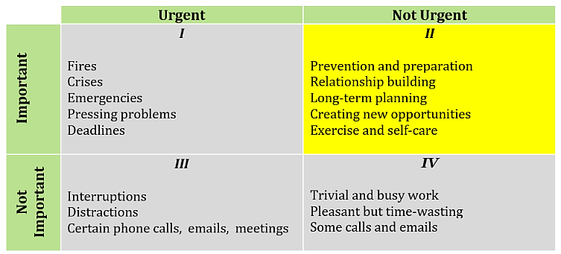
INVEST in QUADRANT II
(activities that are important but not urgent)
Effective people stay out of Q3 & Q4 because,
urgent or not, they are not important. By spending more time in Q2, they have less Q1 (crisis & problems).
Quadrant II is the heart of effective personal management. It deals with things that are not urgent, but are important.
It deals with things like building relationships, writing a personal mission statement, long-range planning, exercising, preventive maintenance, preparation—all those things we know we need to do, but somehow seldom get around to doing, because they are not urgent.

Slide 10

Effective people are not problem-minded;
they’re opportunity minded. They feed opportunities
and starve problems. They think preventively.
They have genuine Q1 crises and emergencies
that require immediate attention, but not so
many. They keep P and PC in balance by focusing on
Quadrant II.
What one thing could you do in your personal and
professional life that, if you did it on a regular basis,
would make a tremendous positive difference in your life?

Slide 11

Quadrant II would make a tremendous positive difference in your life.
If you allot more time in Q2, your effectiveness would increase dramatically.
Your crises and problems would shrink to manageable proportions
because you would be thinking ahead, working on the roots, doing the preventive things that keep situations from developing into crises in the first place.
In time management jargon,
this is called
the Pareto Principle—
80 percent of the results
flow out of 20% of
the activities.

Slide 12

LEARN TO SAY “NO”
To say “yes” to important Q2 priorities, you have to
learn to say “no” to other activities, sometimes even the
urgent things.
You have to decide what your highest priorities are and have the courage— pleasantly and smilingly,—to say “no” to other things. And the way you do
that is by having a bigger “yes” burning inside.
The enemy of the “best” is often the “good.”
Keep in mind that you are always saying “no” to something.
Even when the urgent is good, the good can keep you from your best,
keep you from your unique contribution, if you let it.

Slide 13
Having a Personal Mission Statement is IMPORTANT
Many people recognize the value of Q2 activities in their lives, and they attempt to give them priority and integrate them into their lives through self-discipline alone. But without a principle center and a personal mission statement, they don’t have the necessary foundation to sustain their efforts. They need to examine the roots, the basic paradigms from which their natural attitudes and behaviors flow.
If your priorities grow out of a principle center and a personal mission, if they are deeply planted in your heart and in your mind, you will see Quadrant II as a natural, exciting place to invest your time.
Have you done your Personal Mission Statement?

Slide 14
BECOMING A QUADRANT II SELF-MANAGER
Quadrant II organizing involves four key activities.
1. Identifying Roles
2. Selecting Goals
3. Scheduling
4. Daily Adapting

Slide 15
BECOMING A QUADRANT II SELF-MANAGER
IDENTIFYING ROLES
The first task is to write down your key roles. Ex: husband or wife, mother or father, son or daughter, cousin, employee, employer, new earth builder, etc.
2. SELECTING GOALS
The next step is to think of one or two important results you feel you
should accomplish in each role during the next seven days. These would
be recorded as goals.

Slide 16
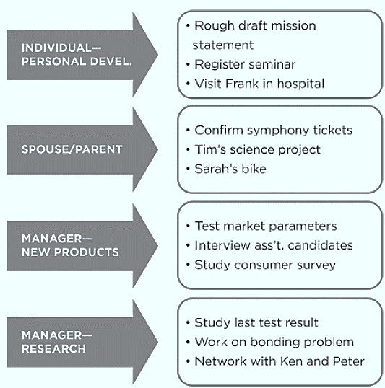

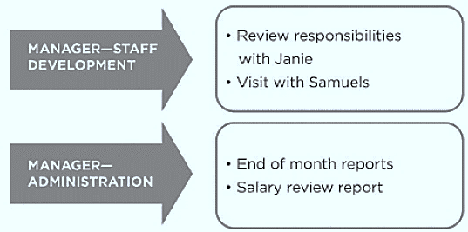
On the right is an example of
Identifying roles and
selecting goals.
At least some of these goals should reflect Quadrant II activities.

Slide 17
BECOMING A QUADRANT II SELF-MANAGER
3. SCHEDULING. Now you can look at the week ahead with your goals in mind and schedule time to achieve them. For example, if your goal is to produce the first draft of your personal mission statement, you may want to set aside a two-hour block of time on Sunday to work on it.
Sunday (or some other day of the week that is special to you, your faith, or your circumstances) is often the ideal time to plan your more personally uplifting activities, including weekly organizing. It’s a good time to draw back, to seek inspiration, to look at your life in the context of principles and values.
If you set a goal to become physically fit through exercise, schedule it 3 to 4 times a week, or possibly every day to accomplish that goal.

Slide 18
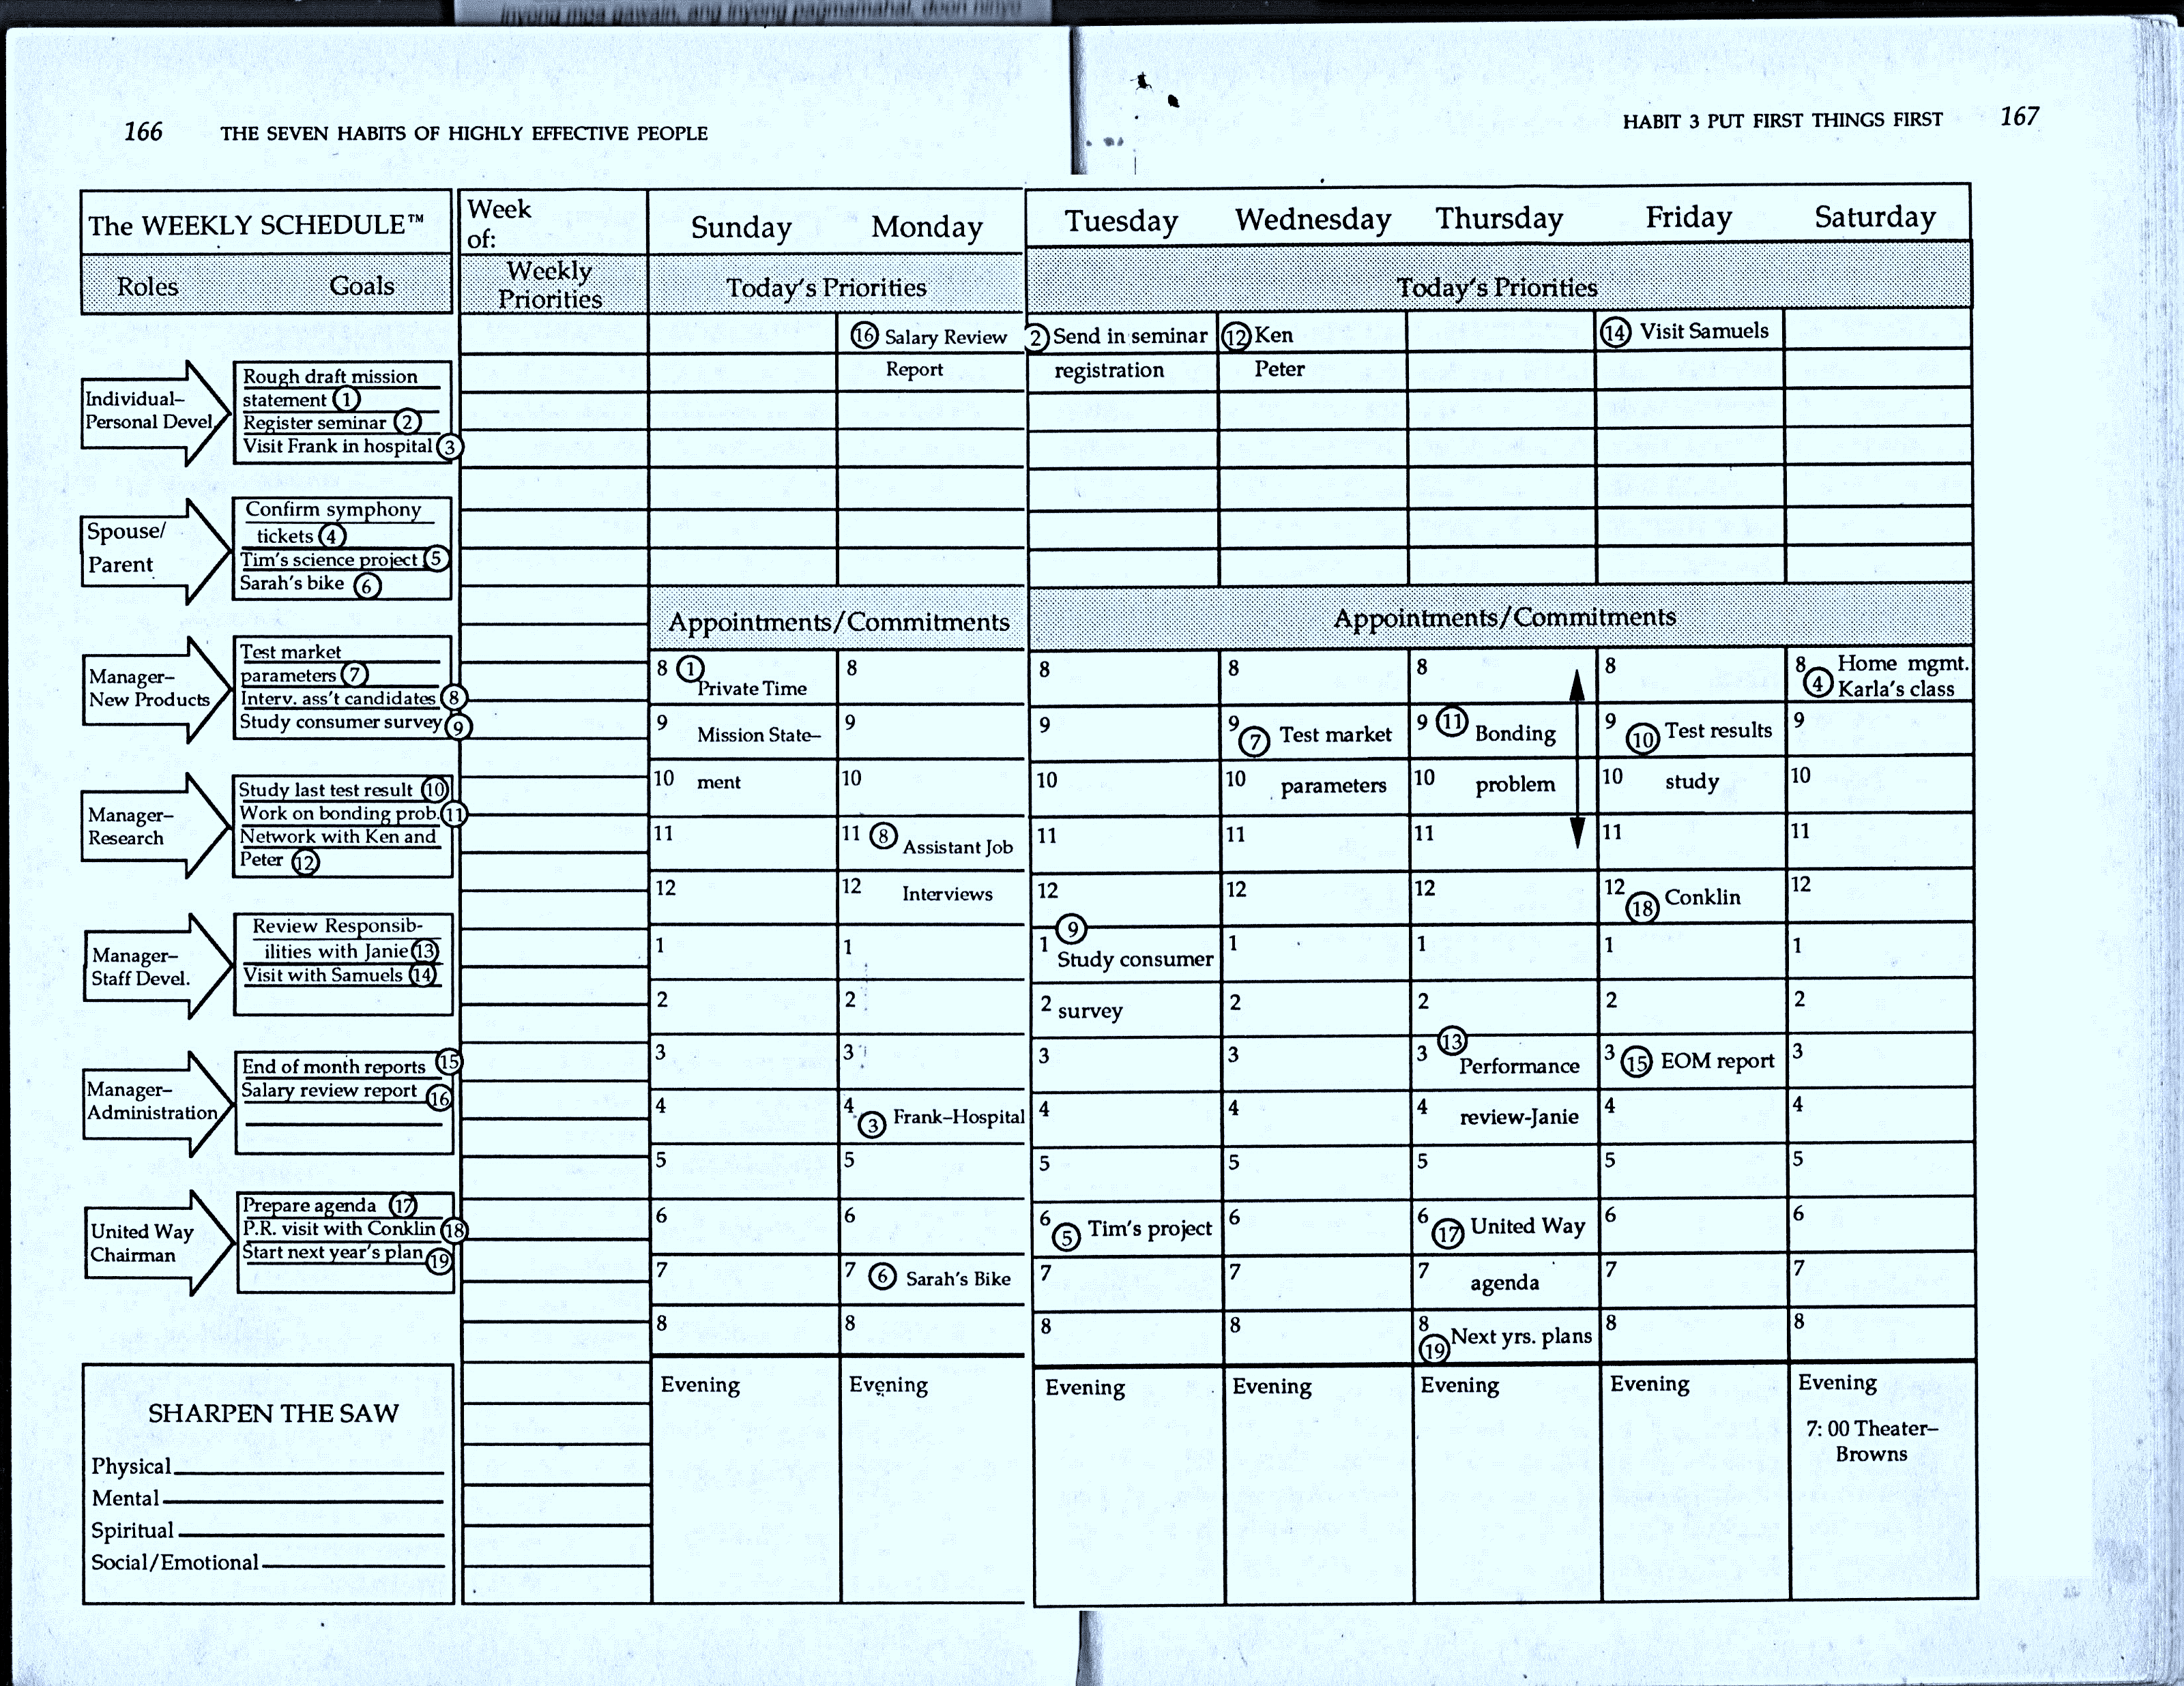
On the right is an example of
Identifying roles and
selecting goals.
At least some of these goals
should reflect Quadrant II
activities.

Slide 19
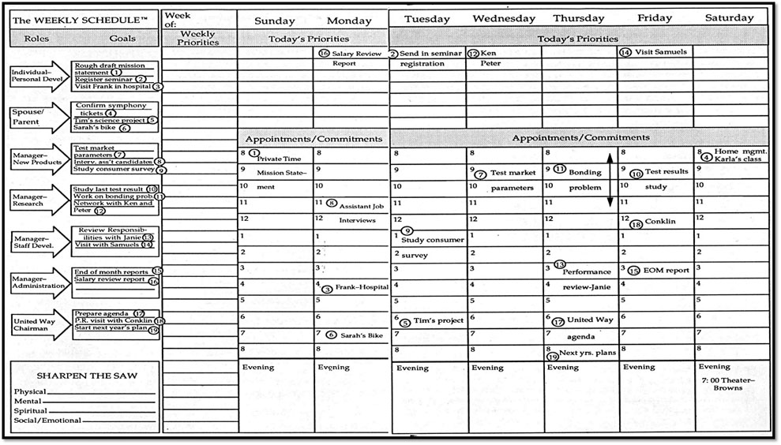
SAMPLE WEEKLY SCHEDULE
Notes:
Blank weekly schedule form available in handout that will be given.

Slide 20
BECOMING A QUADRANT II SELF-MANAGER
4. DAILY ADAPTING. With Quadrant II weekly organizing, daily planning becomes more a function of daily adapting, of prioritizing activities and responding to unanticipated events, relationships, and experiences in a meaningful way.
Taking a few minutes each morning to review your schedule can put you in touch with the value-based decisions you made as you organized the week as well as unanticipated factors that may have come up. As you overview the day, you can see that your roles and goals provide a natural prioritization that grows out of your innate sense of balance and your sense of personal mission.

Slide 21
EFFICIENCY vs. EFFECTIVENESS
One day, one of Stephen Covey’s sons had a very tight schedule, which included down-to-the-minute time allocations for every activity, including picking up some books, washing his car, and “dropping” Carol, his girlfriend, among other things. Everything went according to schedule until it came to Carol. They had been dating for a long period of time, and he had finally come to the conclusion that a continued relationship would not work out. So, consistent with his efficiency model, he had scheduled a 10-15-minute telephone call to tell her.
But the news was very traumatic to her. One-and-a-half hours later, he was still deeply involved in a very intense conversation with her. Even then, one visit was not enough. The situation was a very frustrating experience for them both.

Slide 22
EFFICIENCY vs. EFFECTIVENESS
You simply can’t think efficiency with people. You think effectiveness with people and efficiency with things. Try to be “efficient” with a disagreeing or disagreeable person and it simply doesn’t work. Try to give 10 minutes of “quality time” to a child or an employee to solve a problem, and such “efficiency” creates new problems and seldom resolves the deepest concern.
If you have Habit 2 (Begin with the End in Mind) deep inside your heart and mind, you have those higher values driving you. You can subordinate your schedule to those values with integrity. You can adapt; you can be flexible. You don’t feel guilty when you don’t meet your schedule or when you have to change it.

Slide 23
DELEGATION: INCREASING P & PC
A producer does whatever is necessary to accomplish desired results, to get the golden eggs. A parent who washes the dishes, an architect who draws up blueprints, or a secretary who types correspondence is a producer.
But when a person sets up and works with and through people and systems to produce golden eggs, that person becomes a manager in the interdependent sense.
A parent who delegates washing the dishes to a child is a manager.
An architect who heads a team of other architects is a manager. A secretary who supervises other secretaries and office personnel is an office manager.

Slide 24
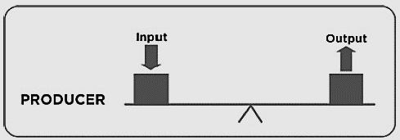
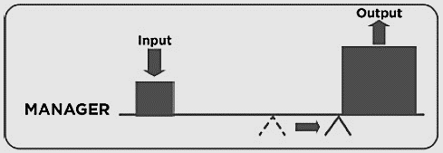
DELEGATION: INCREASING P & PC
A producer can invest one hour of effort and produce one unit of results, assuming no loss of efficiency.
A manager, on the other hand, can invest one hour of effort and produce ten or fifty or a hundred units through effective delegation.
Management is essentially moving the fulcrum over, and the key to effective management is DELEGATION.

Slide 25

2 Kinds of DELEGATION
GOFER Delegation
STEWARDSHIP Delegation
Gofer delegation means
“Go for this, go for that,
do this, do that, and tell
me when it’s done.”

Slide 26
GOFER DELEGATION
An example of gofer delegation is when a manager tells an employee, "Go for this report, go for that document, and make sure you do it exactly like this, then tell me when it's done".
In this style of delegation, the manager provides very specific, step-by-step instructions on how to complete a task, rather than focusing on the desired outcome. This type of delegation is ineffective because it doesn't empower employees, stops their initiative, and keeps the manager too involved in the details. Gofer delegation doesn’t free up the manager to attend to other tasks if she is busy supervising every action her team takes. All in all, gofer delegation is not the type of delegation to pursue when deciding how to delegate effectively.

Slide 27

STEWARDSHIP DELEGATION
Stewardship delegation is focused on results instead of methods.
It gives people a choice of method and makes them responsible for results.
It takes more time in the beginning, but it’s time well invested.
Stewardship delegation involves clear, up-front mutual understanding and commitment regarding
expectations in 5 areas.
Desired Results
Guidelines
Resources
Accountability
Consequences

Slide 28
5 areas of STEWARDSHIP DELEGATION
DESIRED RESULTS. Clearly specify the results that are expected and their timeline. Focus on RESULTS and not the methods. Spend time. Be patient. Visualize the desired result. Have the person see it, describe it, make out a quality statement of what the results will look like, and by when they will be accomplished.
2. GUIDELINES. Identify any guidelines and major restriction within which the person should operate. These should be as few as possible, but DO identify any paths to failure.

Slide 29
5 areas of STEWARDSHIP DELEGATION
3. RESOURCES. Identify all resources available to help in achieving the results: List any human, financial, technical, and organizational resources.
4. ACCOUNTABILITY. Setup the performance standards that will be used in evaluating the results and the specific times when evaluation will take place. The individual is responsible for the evaluation and for ensuring it takes place.
5. CONSEQUENCES. Specify what will happen, both good and bad, as a result of the evaluation (financial rewards and other rewards, different job assignments, and natural consequences tied into the overall mission of an organization.)

Slide 30
Example of STEWARDSHIP DELEGATION
Stephen Covey had an interesting experience in delegation with one of his sons. They were having a family meeting, and they had their mission statement up on the wall to make sure their plans were in harmony with their values. He set up a big blackboard and they wrote down their goals and the jobs that flowed out of those goals. Then he asked for volunteers to do the job. His 7-year-old son, Stephen (Jr.), volunteered to take care of the yard.
Before Stephen actually gave him the job, he began a detailed training process. He wanted Stephen (Jr.) to have a clear picture in his mind of what a well cared for yard was like, so he took him next door to their neighbor’s.
Pls. watch next video.

Slide 31


Slide 32
Stephen (Jr.) only asked for help 2-3 more times that entire summer then he took care of that yard by himself maintaining it green and clean. He even reprimanded his brothers and sisters if they left so much as a gum wrapper on the lawn.
Trust is the highest form of human motivation. It brings out the very best in people. But it takes time and patience. If stewardship delegation is done correctly, both parties will benefit and much more work will get done in much less time.

Slide 33

A family that is well organized, whose time has been spent effectively delegating on a one-on-one basis, can organize the work so that everyone can do everything in about an hour a day. But that takes the internal capacity to want to manage, not just to produce. The focus is on effectiveness, not efficiency.
Certainly you can clean up the living room better than a child, but the key is that you want to empower the child to do it. It takes time. You have to get involved in the training and development. It takes time, but it saves you so much in the long run.

Slide 34
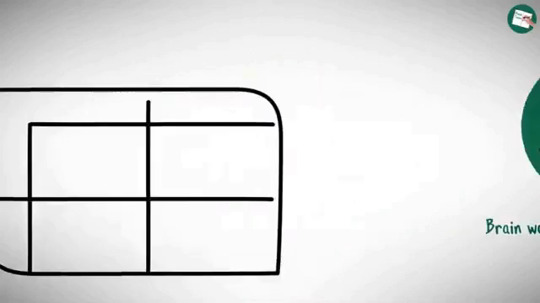
Notes:
THIS IS A VIDEO. PLS. PLAY.

Slide 35
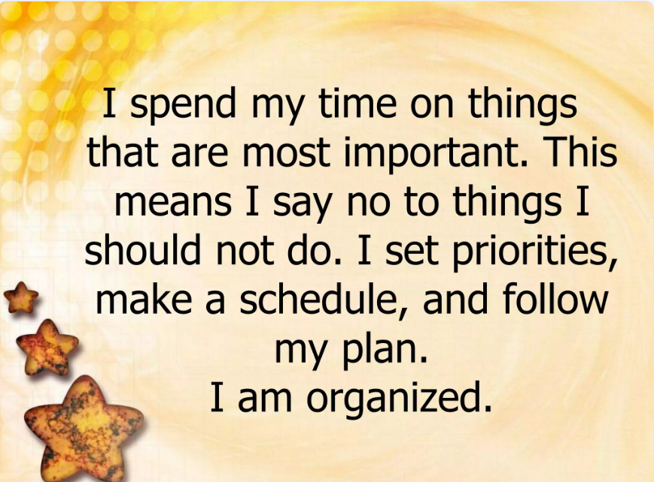

Slide 36


Slide 37
Assignment:
Identify a Quadrant II activity you know has been neglected in your life—one that, if done well, would have a significant impact in your life, either personally or professionally. Write it down and commit to implement it.
2. Draw a time management matrix and try to estimate what percentage of your time you spend in each quadrant. Are you satisfied with the way you spend your time? What do you need to change?

Slide 38
3. Make a list of responsibilities you could delegate and the people you could delegate to or train to be responsible in these areas. Determine what is needed to start the process of delegation or training.
4. Organize your next week. Start by writing down your roles and goals for the week, then transfer the goals to a specific action plan. At the end of the week, evaluate how well your plan translated your deep values and purposes into your daily life and the degree of integrity you were able to maintain to those values and purposes.
5. Commit yourself to start organizing on a weekly basis and set up a regular time to do it.

